Slide 1
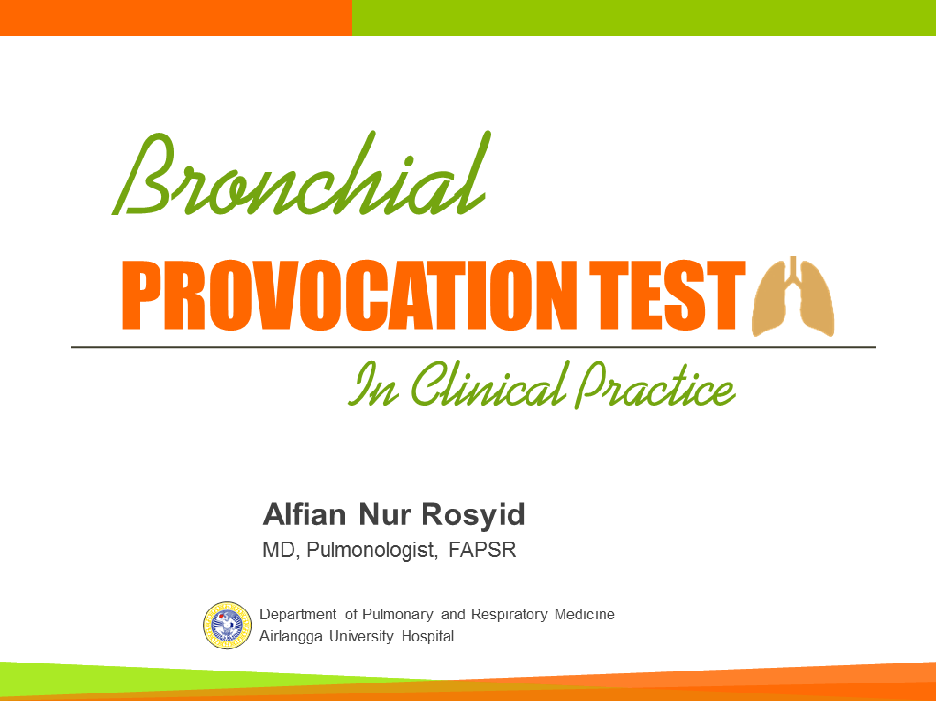

Slide 2














Menu
Bronchial Hyper responsiveness
Provocation test
Definition
Airway Smooth Muscle
Diseases with BHR
Pathogenesis
Indication
Contra Indication
Test
Spirometer
Direct / Indirect
Tidal / Five Breathing
Methods
Result
Analysis
Interpretation

Slide 3
Definition
AHR / BHR:
Airway / Bronchial Hyper Responsiveness:
“Over / Hyper Response of bronchus to external agent, occur bronchoconstriction”
(Brannan, JD and Lougheed, MD, 2012)

Slide 4
Definition
Bronchial provocation tests (BPTs)
are objective tests for AHR that are clinically useful to aid in the diagnosis of asthma in both adults and children.
BPTs = Bronchial Provocation Test
BCTs =Bronchial Challenge Tests
Ex: Methacholine Challenge test (MCT)
Exercise Challenge test
(Brannan, JD and Lougheed, MD, 2012)

Slide 5
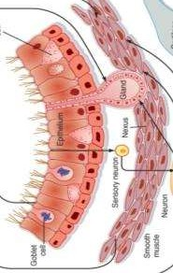
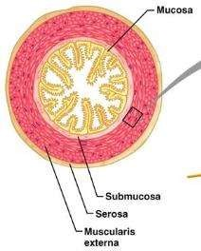
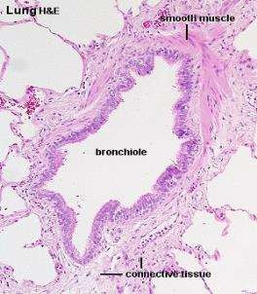




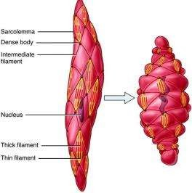
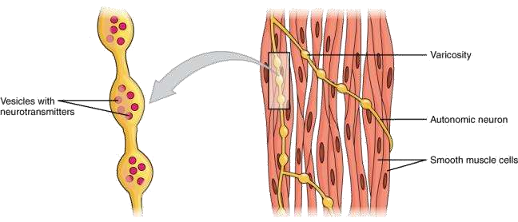


Pathogenesis
James. Swiss Med Weekly, 2010; 140: 1-6

Slide 6
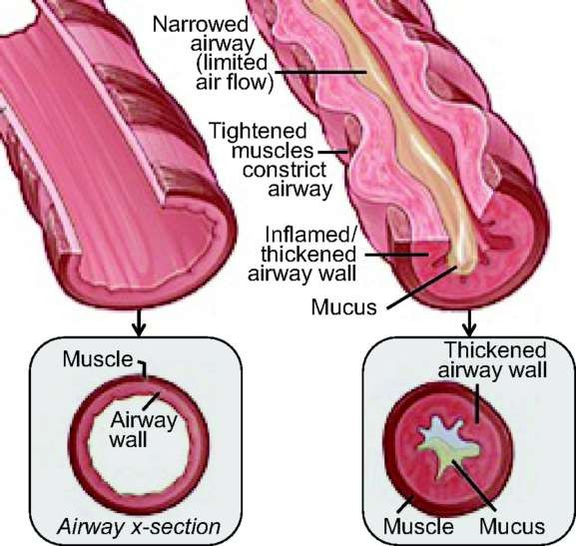
Asthma
Normal
Doeing DC and Solway J, 2013

Slide 7
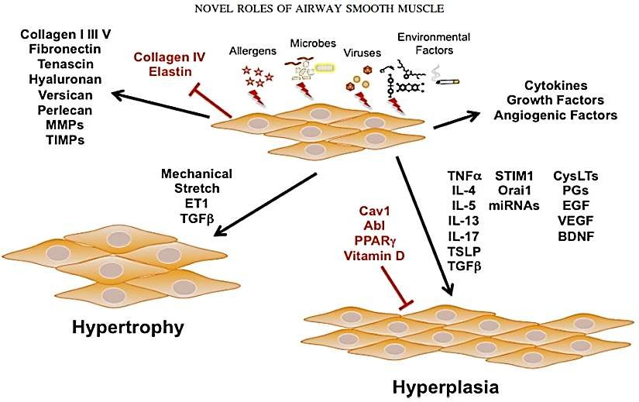
Pathogenesis
Prakash. Am J Physiol Lung Cell Mol Physiol, 2013; 305: L912–L933.

Slide 8
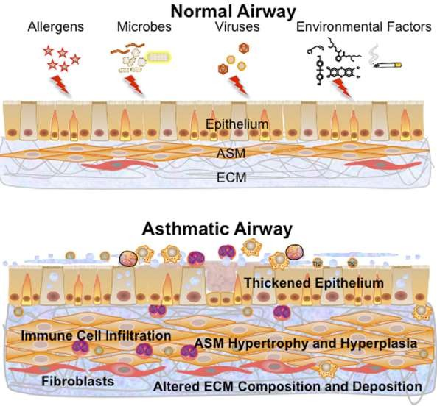
Prakash. Am J Physiol Lung Cell Mol Physiol, 2013; 305: L912–L933.

Slide 9
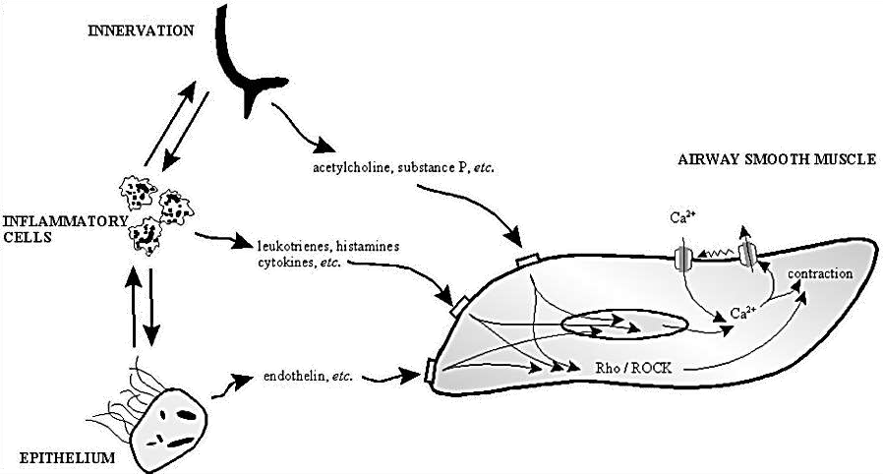
Pathogenesis
Janssen. Respiratory Research, 2006; 7(123): 1-6.

Slide 10
Methods
Bronchial provocation tests (BPTs)
stimulus mediates bronchoconstriction.
can be either “direct” or “indirect,”
Direct: stimulus act on specific receptors on the ASM
Indirect: stimulus causes the release of mediators of bronchoconstriction from inflammatory cells
(Brannan, JD and Lougheed, MD,, 2012)

Slide 11
Type
BPT
Direct
Indirect
Methacholine
Histamine
Exercise
Manitol
Hypertonic Saline
Adenosine monophosphate (AMP)
Eucapnic Voluntary Hyperventilation (EVH)
Food additive challenge
Antigen challenge

Slide 12
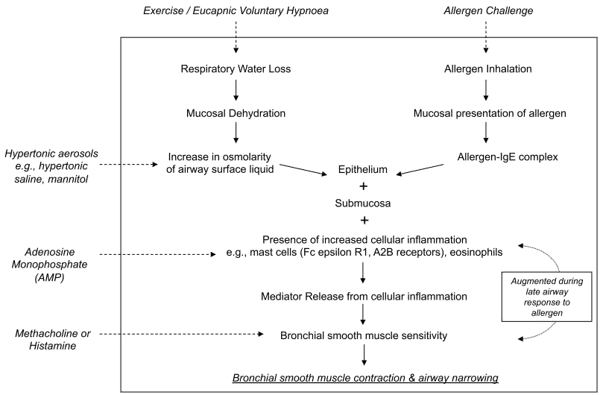
A schematic demonstrating the mechanism of action
(Brannan, JD and Lougheed, MD,, 2012)

Slide 13

Where is Better?
Histamine
Methacholine
Exercise
Hypertonic saline
Mannitol
Allergen

Slide 14
Methods
Methacholine challenge testing (MCT)
is one method of assessing airway responsiveness.
It may vary over time, often increasing during exacerbations and decreasing with anti inflammatory.
Test is safety, during preparation and procedure are good.
Inhaled methacholine causes bronchoconstriction → few adverse effects
Crapo. Am J Respir Crit Care Med, 2000; 161: 309-329.

Slide 15
Indication
Excluding the diagnosis of asthma (its NPV > PPV)
Relative risk of developing asthma
If BHR test result is
Assess of asthma severity
Monitor of asthma therapy
Occupational Asthma
Negative, it will exclude the diagnosis of Asthma
Most subjects with current asthma
symptoms will have BHR
Crapo. Am J Respir Crit Care Med, 2000; 161: 309-329.

Slide 16
Indication
Symptoms with asthma but normal PFT and no response to a bronchodilator → mild or well-managed asthma
Atypical symptoms of bronchospasm (i.e., nocturnal awakening).
Nonspecific symptoms that could asthma (i.e., cough)
Screening test for asthma (ex: scuba divers, military personnel, athletes or others)
Goldstein MF, Chest 1994; 105:1082.
Rubinfeld AR, Lancet 1976; 1:882
Irwin RS, Am Rev Respir Dis 1990; 141:640

Slide 17
Indication
Asthma Bronchial
COPD
Congestive Heart Failure (CHF)
Cystic fibrosis
Bronchitis
Allergic rhinitis
However, bronchial hyperresponsiveness is also seen in a wide variety of other disease
Crapo. Am J Respir Crit Care Med, 2000; 161: 309-329.

Slide 18

Contra Indication
Absolute
Severe airflow limitation (FEV1 <50 percent predicted or <1 L)
Myocardial infarction or stroke in last three months
Uncontrolled hypertension (systolic BP >200 or diastolic BP >100)
Known aortic aneurysm
Relative
Moderate airflow limitation (FEV1 <60 percent predicted or <1.5 L)
Inability to perform acceptable-quality spirometry
Pregnancy
Nursing mothers
Current use of cholinesterase inhibitor medication (for myasthenia gravis)
Crapo. Am J Respir Crit Care Med, 2000; 161: 309-329.

Slide 19
Preparation
Adverse Effect
Patient
Operator
Tools
Quali-
fication
Provocation tools
Broncho dilator
Drugs to Avoid
Spirometer
Oxygen
Spirometer Baseline
Avoid asthma
Application
ICU
Good preparation → good result → minimal adverse effect

Slide 20
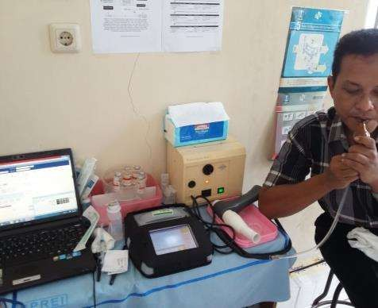
Preparation
Provocation test device
Agents:
  Methacholine
  Histamine
  Manitol
  Hypertonic saline etc
Spirometer
Computer application
Crapo. Am J Respir Crit Care Med, 2000; 161: 309-329.

Slide 21
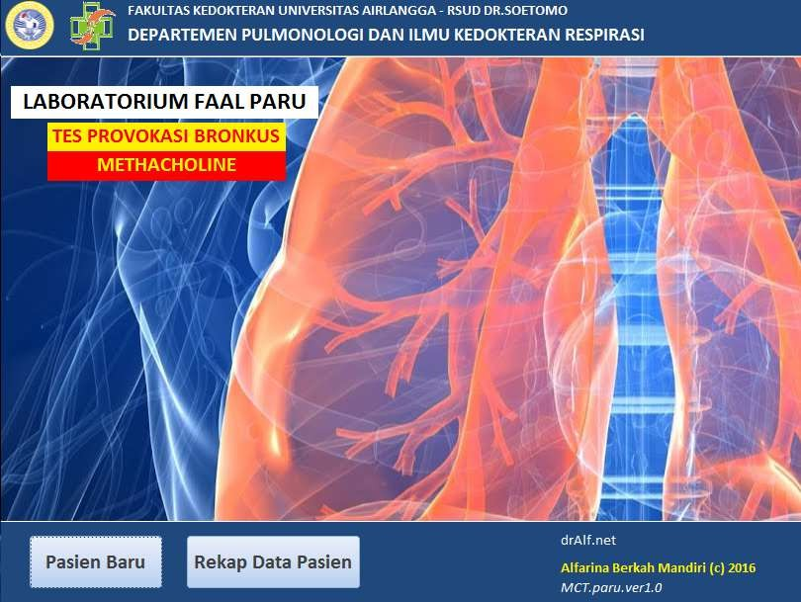

Slide 22
Technics
Spirometer (FVC maneuver)
Asses FEV1
Resting
Resting
Methacholine inhalation

Slide 23


Technics
Methacholine Challenge Test
2-minute Tidal breathing
Five-breath dosimeter
No significance difference of both technics
FDA approve five-breath (5 level of concentration)
ATS prefer tidal breathing (10 level of concentration)
Crapo. Am J Respir Crit Care Med, 2000; 161: 309-329.
Cockroft. Chest, 2008; 1344: 678-680.

Slide 24


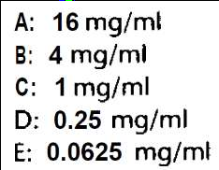
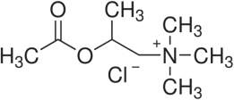
Methacholine (Powder + Diluent NaCl 0,9%)
A
16
B
4
A
B
C
D
E
C
1
D
0,25
E
0,0625
Diluent (NaCl 0,9%)

Slide 25





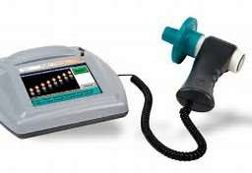




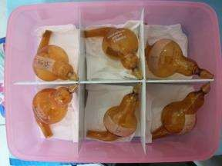
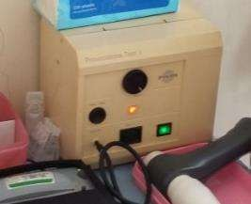
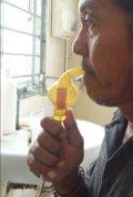
Give Bronchodilator
Technics
Stop if FEV1 decrease
≥ 20% FEV1 baseline
Continue if FEV1 decrease
< 20% FEV1
baseline
FEV1 decrease
Bronchoconstriction
Methacholine 2 cc
Concentration: … mg/ml
Provocation device test

Slide 26

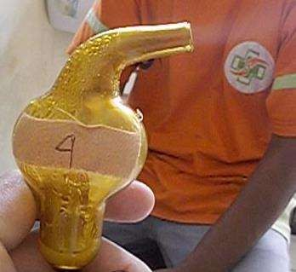

Slide 27
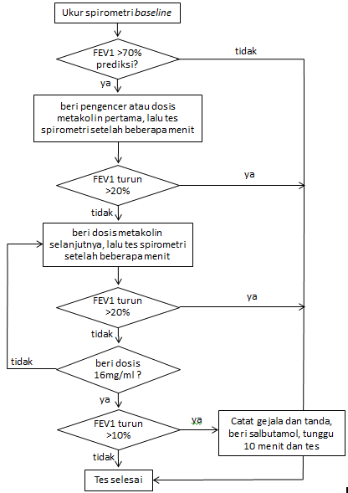














E
D C B
A
Crapo. Am J Respir Crit Care Med, 2000; 161: 309-329.

Slide 28
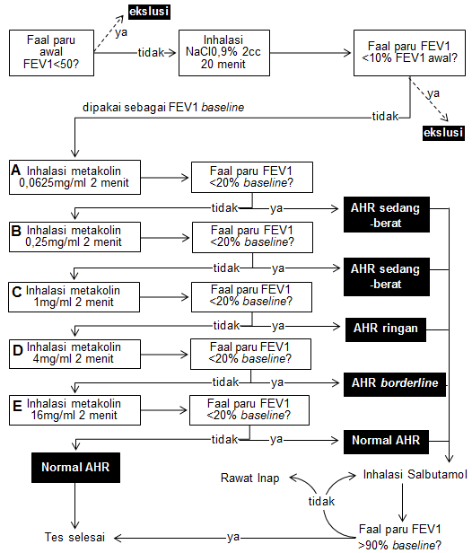
E
D
C
B
A

Slide 29
(log C2 − log C1)(20 − 𝑅1)
PC20 = antilog log C1 +
𝑅2 − 𝑅1
C1 = second-to-last methacholine concentration (concentration preceding C1).
C2 = final concentration of methacholine (concentration resulting in a 20% or greater fall in FEV1)
R1 = percent fall in FEV, after C1
R2 = percent fall in FEV, after C2
0
-10
-20
-30
FEV1 % decrease
-40
PC20= 3,7
Mild BHR
-50
-60
-70
0
0,0625 0,25 1 4
Methacholine consentration (mg/ml)
16
Crapo. Am J Respir Crit Care Med, 2000; 161: 309-329.

Slide 30
Results
ATS 1999
PC₂₀ (mg/ml)
>16 | Normal (test negative)
4-16 | BHR borderline
1-4 | BHR mild (test positive)
<1 | BHR moderate to severe
Crapo. Am J Respir Crit Care Med, 2000; 161: 309-329.

Slide 31
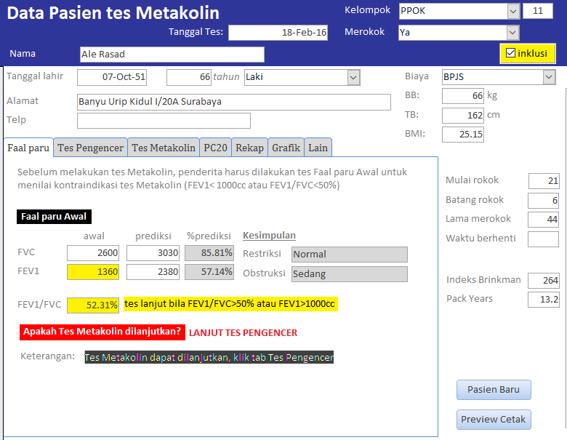

Slide 32
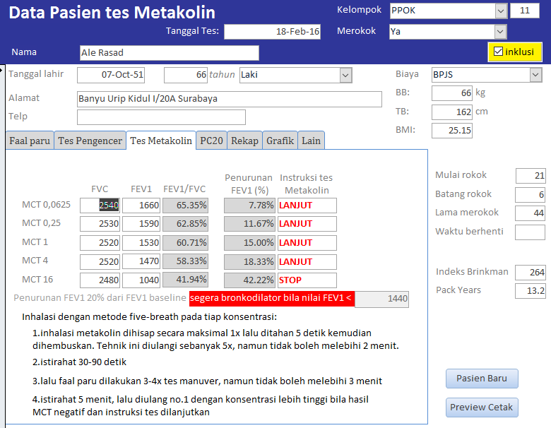

Slide 33
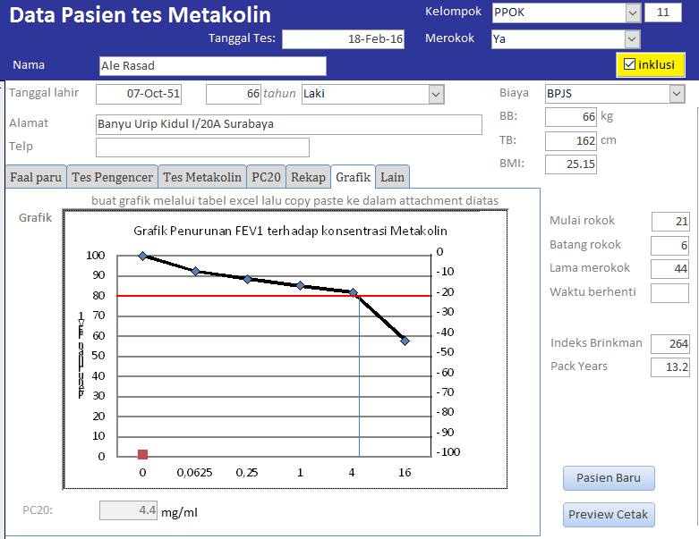

Slide 34
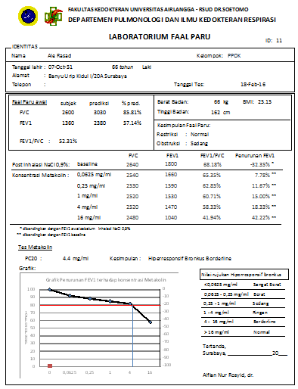
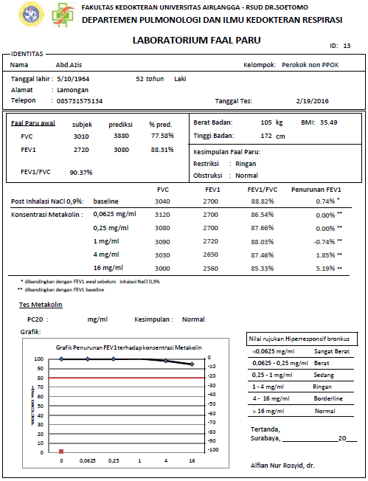

Slide 35
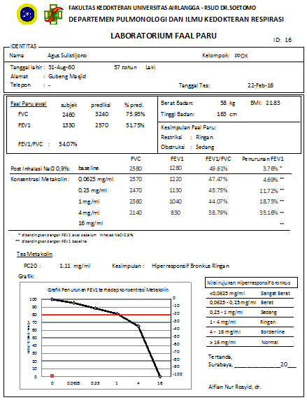
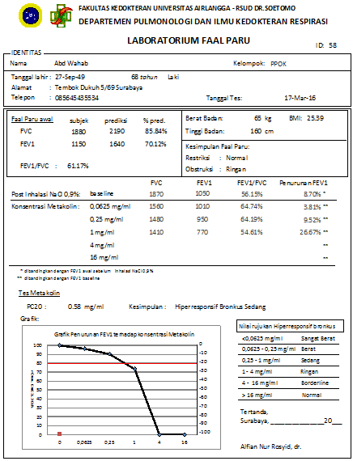

Slide 36
Conclusions
Several types of bronchial provocation test are available to assess airway responsiveness
Methacholine challenge test is save with good preparation
Five-breath dosimeter with 5 concentration (0,0625; 0,25;
1; 4; 16 mg/ml)
PC20 ≤ 4 mg/ml → BHR positive
Negative Predictive Value → Exclude Asthma

Slide 37




Thank You
You can download free this slide in:
bit.ly/mct2017

